Slide 1
Capstone project 1
Hotel Booking Analysis

Slide 2
acknowledgement
I would like to express my deepest gratitude to the “ALMABETTER TEAM” for giving us the opportunity to do this great project on “HOTEL BOOKING ANALYSIS”.
I would also like to thank all the instructors (Mr. Rochit Jain, Mr. Tejas Aggarwal , Mr. Sankalp Jain) who have guided us ,given practical suggestions and providing all the necessary resources and facilities, without those resources this project would not have been completed.
I would also like to thank my parents ,my husband and team mates who helped me a lot in finalizing this project within the limited time frame. Thanks again to all, whose guidance and supervision brought the project to its present state.
The journey of making this project has been beautiful, as well as knowledgeable for me and I have learned a lot from it.

Slide 3
MEET OUR TEAM
VARSHA SAXENA
ANUP SINGH
HRTHIK VINODIA​

Slide 4
AGENDA
Introduction​
About the Data set
​Business Problem
Assumptions and Hypothesis
Research Questions
EDA(Exploratory data analysis)
​Summary​

Slide 5
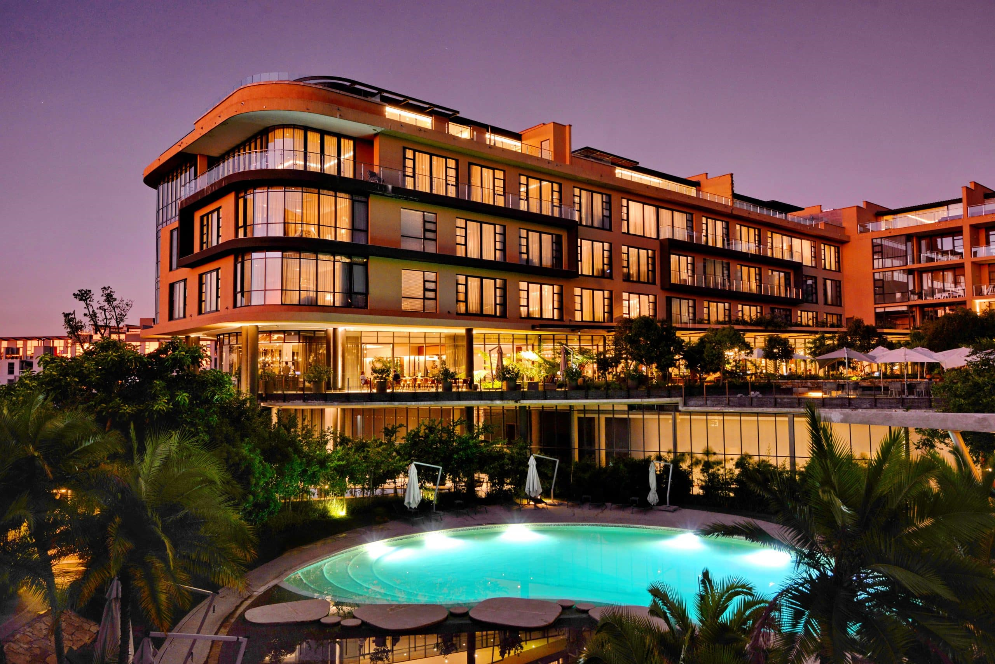

Introduction
HOTEL BOOKING ANALYSIS:
Hotel industry is a very volatile industry and the bookings depend on variety of factors such as type of hotels, seasonality, days of week and many more. This makes analyzing the patterns available in the past data more important to help the hotels plan better. Using the historical data, hotels can perform various campaigns to boost the business. We can use the patterns to predict the future bookings using time series or decision trees.
We will be using the data available to analyze the factors affecting the hotel bookings. These factors can be used for reporting the trends and predict the future bookings.

Slide 6
process
BUSINESS PROBLEM
Data collection
Data cleaning
Perform EDA
DATA VISULIZATION
What the basic problem faced by the clients
Collect the data accordingly
Eliminating null values ,changing the data types etc
Exploratory data analysis
graphs

Slide 7
Business problem
In recent years, City Hotel and Resort Hotel have seen high cancellation rates. Each hotel is now dealing with several issues as a result, including fewer revenues and less than ideal hotel room use. Consequently, lowering cancellation rates is both hotels’ primary goal in order to increase their efficiency in generating revenue, and focus to offer thorough business advice to address this problem.
The analysis of hotel booking cancellations as well as other factors that have no bearing on their business and yearly revenue generation are the main topics of this report.

Slide 8
About the data set
This dataset contains 119390 observations for a City Hotel and a Resort Hotel. Each observation represents a hotel booking between the 1st July 2015 and 31st August 2017, including booking that effectively arrived and booking that were cancelled. Since this is hotel real data, all the elements pertaining hotel or customer identification were deleted. Four Columns ,name, email, phone no. and credit-card have been artificially created and added to the dataset.
The project contains the real-world data record of hotel bookings of a city and a resort hotel containing details like bookings, cancellations, guest details etc. from 2015 to 2017. In this project we are going to analyze Hotel Booking Data in order to find out valuable insights and give suggestions to increase revenue of hotels.
Programming Language: Python
Libraries used: Pandas, NumPy, Matplotlib, Seaborn
Notebook: Google Collab
Dataset Source: Provided by Almabetter

Slide 9
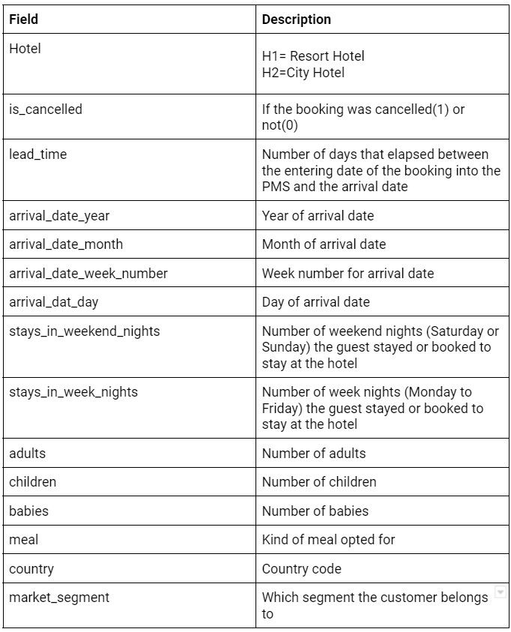

Slide 10
Assumptions/hypothesis
Assumptions :
Hypothesis :
No unusual occurrences between 2015 and 2017 will have a substantial impact on the data used.
The information is still current and can be used to analyze a hotel’s possible plans in an efficient manner.
The hotels are not currently using any of the suggested solutions.
The biggest factor affecting the effectiveness of earning income is booking cancellations.
Cancellations result in vacant rooms for the booked length of time.
Clients make hotel reservations the same year they have make cancellations.
More cancellations occur when the prices are higher.
When there is a longer waiting list, customers tend to cancel more frequently.
Most clients are coming from offline travel agents to make their reservations.
Transient Groups must be giving a large number of customers.
Hotels must be busy during May-July and December since more holidays are there.
Aviation people prefer city over resort more since they city hotels are closer to airport therefore there stay must be in cities hotels rather than resort hotels.

Slide 11
Reseach questions
Which factor has significant impact on the revenue of the hotels?
Is cancellation more in city or resort hotel?
What are the variables that affect hotel reservation cancellations?
In which month the cancellation is the highest and in which month it is the lowest?
In which country the cancellation rate is the highest? Also show top 10 countries whose cancellation rate is highest?
How many guests are there who have repeatedly cancelled the bookings?
In which hotel people like to stay and spend more time depending on the market segment?
How many bookings were cancelled? Calculate its percentage depending on the hotel type.
What are the effects on cancellations by market segments.
What are the various types of the customers in the data set and also show how much percentage of customers are coming from which type?
How can we make hotels reservations cancellations better?
How will hotels be assisted in making pricing and promotional decisions?

Slide 12
e.d.a (Exploratory data analysis)

Slide 13
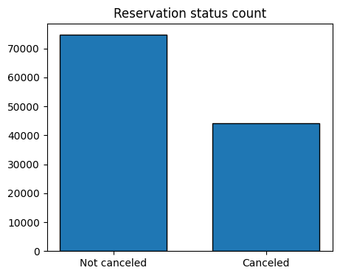
Analysis & Findings
Graph 1:
Conclusion/findings
The accompanying bar graph shows the percentage of reservations that are cancelled and those that are not. It is obvious that there are still a significant number of reservations that have not been canceled. There are still 37% of the clients who canceled their reservation , which has a significant impact on the hotel’s earning.

Slide 14
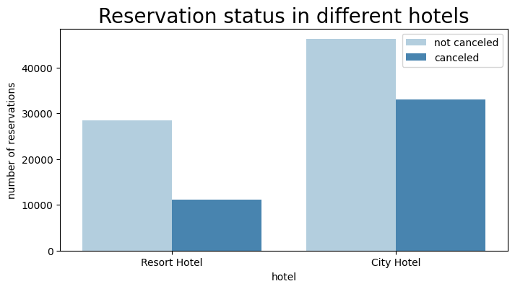
Analysis & Findings
Graph 2:
Conclusion/findings
In comparison to resort hotels, city hotels have more bookings. It’s possible that resort hotels are more expensive than those in cities.

Slide 15
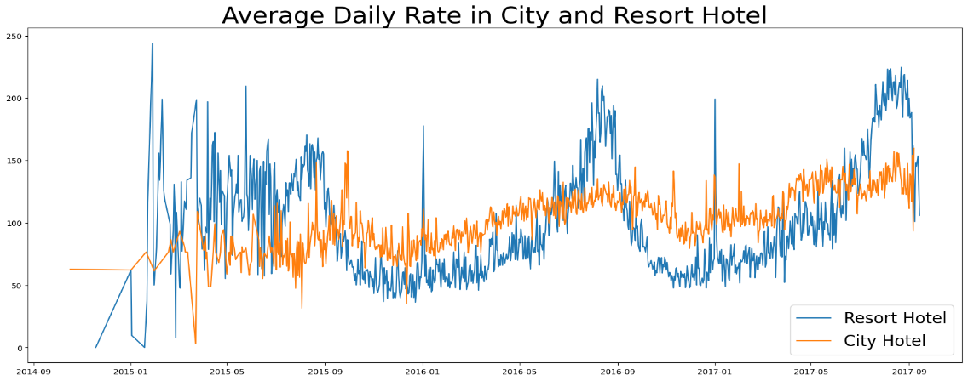
Analysis & Findings
Graph 3:
Conclusion/findings
The line graph above shows that on certain days, the average daily rate for a city hotel is less than that of a resort hotel, and on the other days, it is even less. It goes without saying that weekends and holidays may see a rise in resort hotel rates.

Slide 16
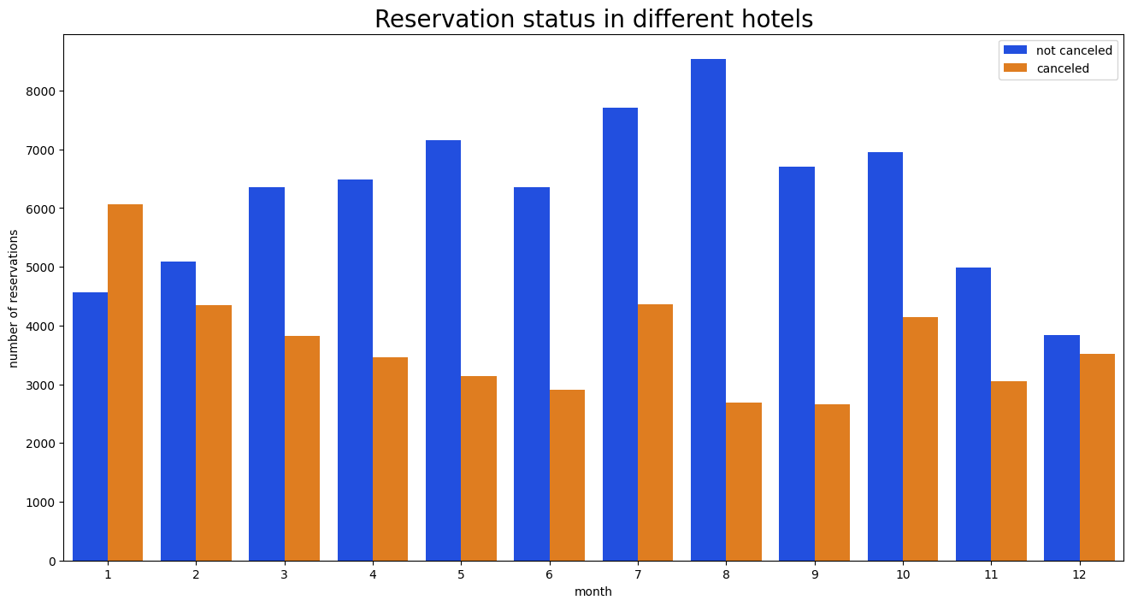
Analysis & Findings
Graph 4:
Conclusion/findings
We have developed the grouped bar graph to analyze the months with the highest and lowest reservation levels according to reservation status.As can be seen, both the number of confirmed reservations and the number of canceled reservations are largest in the month of August, whereas January is the month with the most canceled reservations.

Slide 17
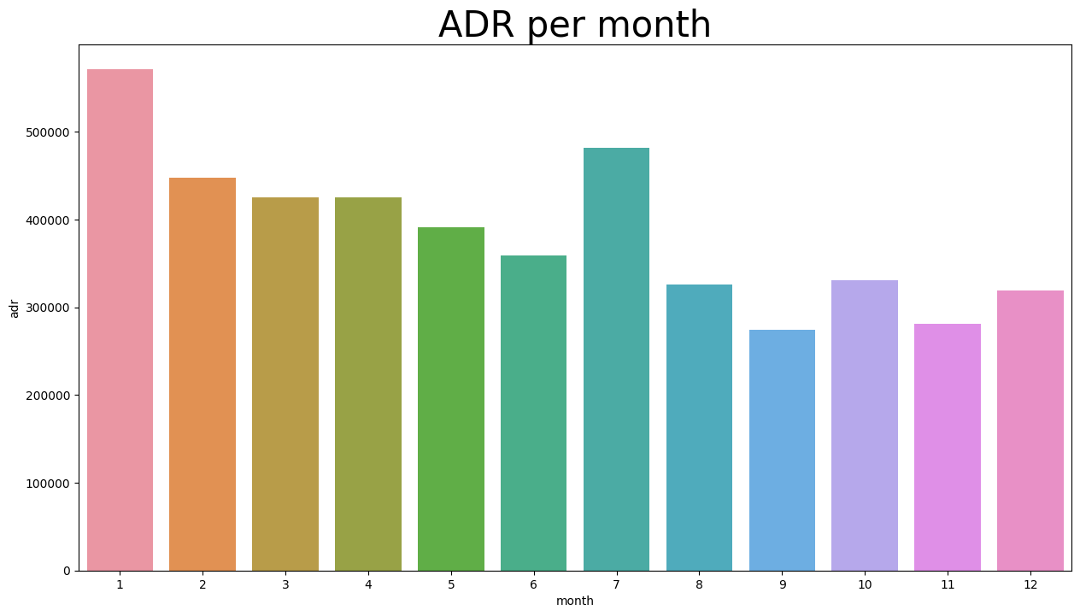
Analysis & Findings
Graph 5:
Conclusion/findings
This bar graph demonstrates that cancellations are most common when the prices are greatest and are least common when they are lowest. Therefore the cost of the accommodation is solely responsible for the cancellation

Slide 18
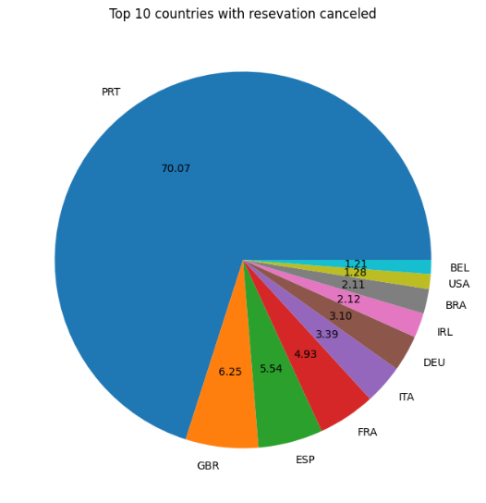
Analysis & Findings
Graph 6:
Conclusion/findings
The above pie chart demonstrates the top 10 countries with highest rate of cancellations. The top country is Portugal with the highest number of cancellations.

Slide 19
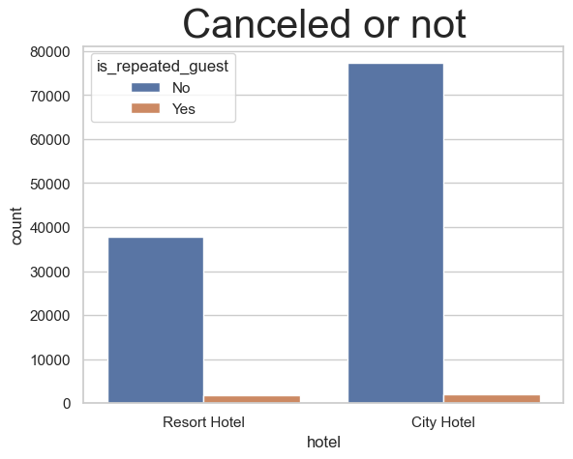
Analysis & Findings
Graph 7:
Conclusion/findings
The above graph shows how many no. of guests are there who have repeatedly canceled the bookings.

Slide 20
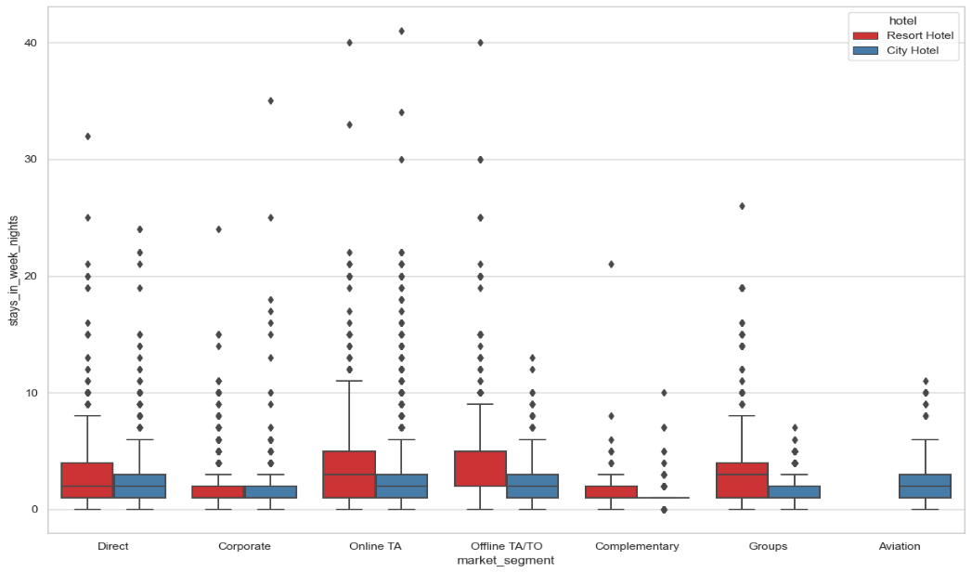
Analysis & Findings
Graph 8:
Conclusion/findings
The graphs shows that in which hotel people like to stay and spend more time depending on the market segment.
Looking at the distribution, it can be concluded that most people do not seem to prefer to stay at the hotel for more than 1 week. But it seems normal to stay in resort hotels for up to 12–13 days.
As it turns out, customers from Aviation Segment do not seem to be staying at the resort hotels and have a relatively lower day average.

Slide 21
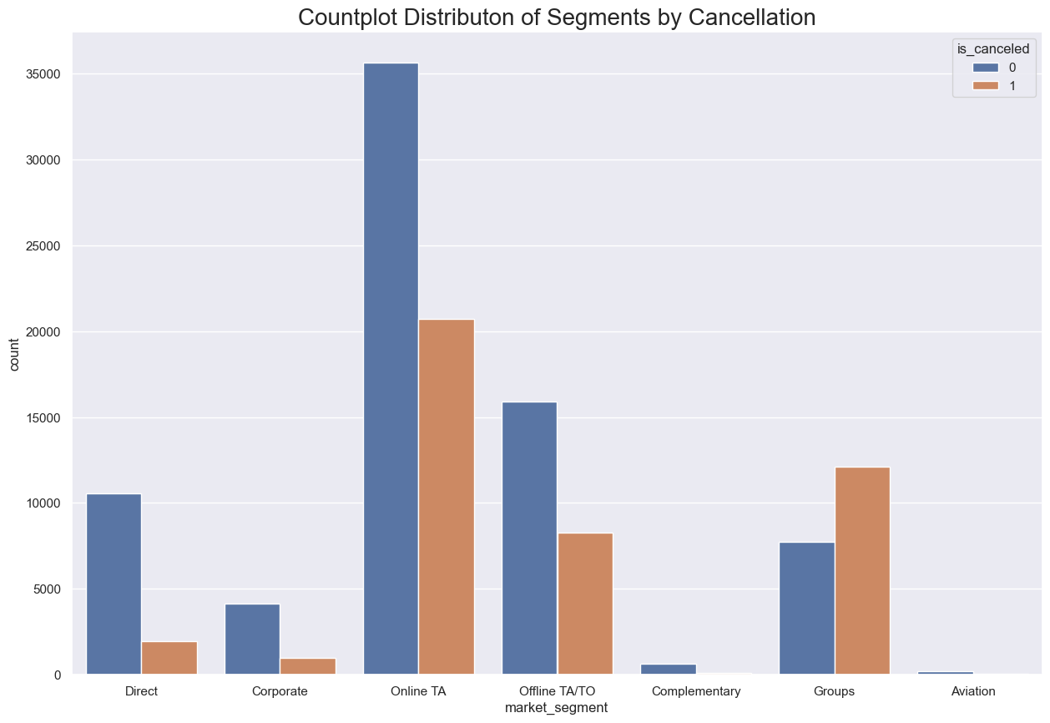
Analysis & Findings
Graph 9:
Conclusion/findings
The cancellation rate for groups is greater than 50%.The cancellation rate for offline TA/TOs (Travel Agents/Tour Operators) and online TAs is greater than 33%.Direct segments have a lower rate of cancellation. Online reservation cancellation rates are typical for a dynamic environment with significant circulation.

Slide 22
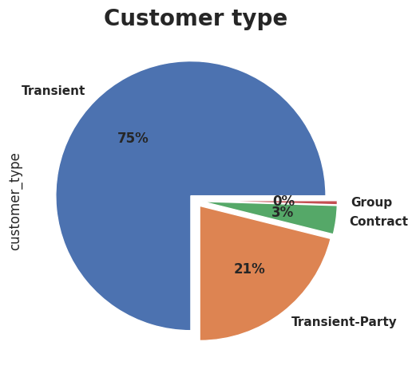
Analysis & Findings
Graph 10:
Conclusion/findings
From the graph we can easily see that maximum customers are from transient category i.e nearly 75% whereas from groups and contract we are having a negligible customers.

Slide 23
Suggestions
Cancellation rates rises as the prices does. In order to prevent cancellations of reservations, hotel could work on their pricing strategies and try to lower the rates for specific hotels based on locations. They can also provide some discounts to the customers.
As the ratio of the cancellation to the non-cancellation of the resort hotels is higher than the city hotels. So the hotels should provide a reasonable discount on the room prices on weekends or on holidays.
In the month of January, hotels can start campaigns or marketing with a reasonable amount to increase their revenue as the cancellations is the highest in this month.
They can also increase the quality of their hotels and their services mainly in Portugal to reduce the cancellation rate.
Repeated guests do not cancel their reservations. Of course, there are some exceptions. So we can offer some discount or privilege in terms of giving one meal free or any services free can be given to attract them back.

Slide 24
THANK YOU
ALL

